Slide 1
MINOR PROJECT AND ENTREPRENEURSHIP
DEPARTMENT OF COMPUTER APPLICATIONS
University of Engineering & Management (UEM),
Kolkata
Topic- Payroll Management System

Slide 2
PRESENTED BY - GROUP 1
SUMANA KHAN, ROLL NO.-01
PRITAM CHAKRABORTY, ROLL NO.-02
NITIN JAIN, ROLL NO.-03
BIVABASU MAJUMDAR, ROLL NO.-04
SUBHAJEET BAGCHI, ROLL NO.-05

Slide 3
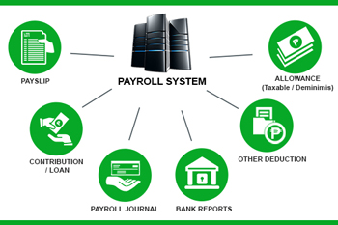
INTRODUCTION
Payroll accounting is essentially the calculation, management, recording, and analysis of employees’ salary.
Payroll accounting also includes reconciling for benefits, and withholding taxes.
The calculation of payroll is highly influenced by each country’s legal requirements.

Slide 4
FUNCTIONALITIES OF PAYROLL MANAGEMENT SYSTEM
Admin and User Login
Tracking Monetary Transaction
Tax updates
Create Payslips
Efficient working

Slide 5


Slide 6
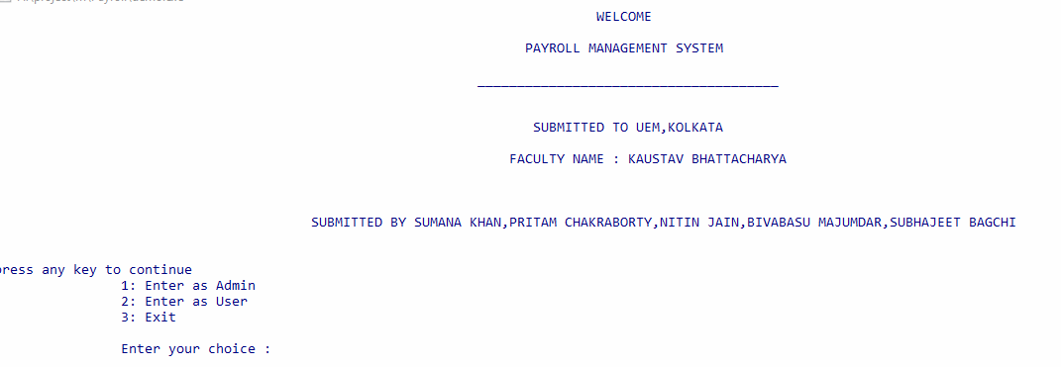
WELCOME MESSAGE
First click on Payrollaccounting.exe, then the interface will be displayed like shown below

Slide 7
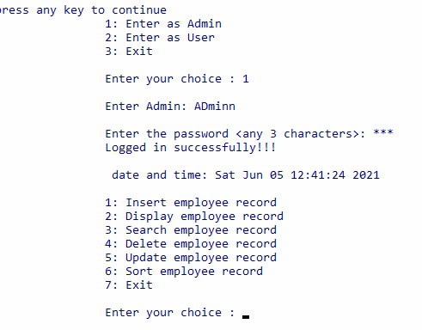
ADMIN LOGIN
When we choose option 1 this interface will appear

Slide 8
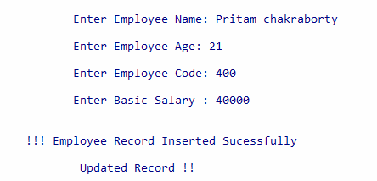
INSERT RECORD
Enter Employee details

Slide 9
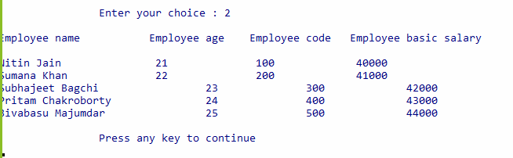
DISPLAY RECORD
Here is the details of employees

Slide 10
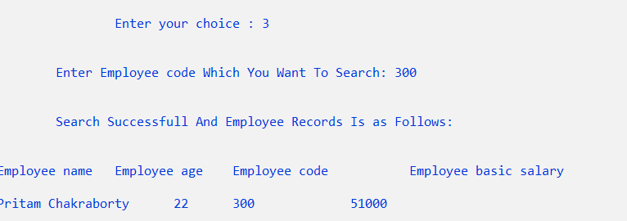
SEARCH RECORD
For searching an employee’s record by typing the respective employee code

Slide 11
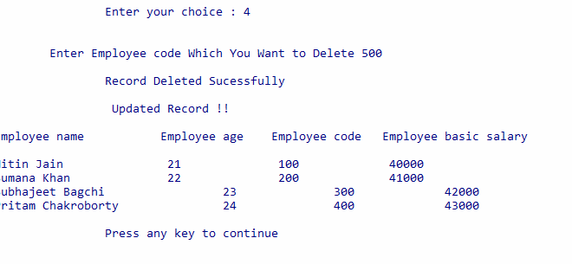
DELETE_RECORD
For deleting an employee’s record by typing the respective employee code

Slide 12
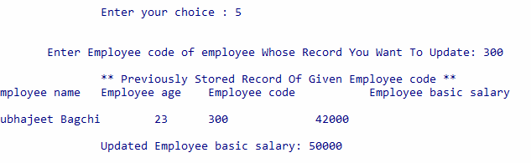
UPDATE RECORD
For updating an employee’s record by typing the respective employee code

Slide 13
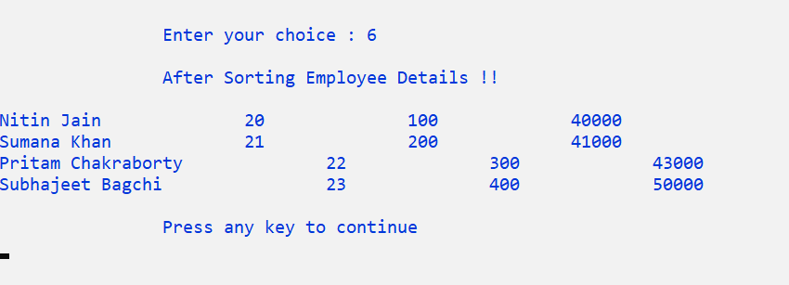
SORT RECORD
Sorted Employee details according to employee code

Slide 14
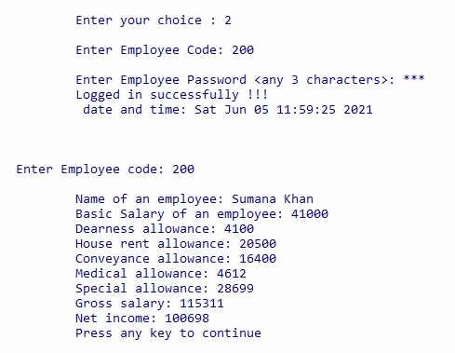
USER LOGIN
After choosing 2 this interface will appear

Slide 15
CONCLUSION
This project developed for a company has been designed to
achieve maximum efficiency and reduce the time taken to
handle the Payroll activity. It is designed to replace an existing
manual record system thereby reducing time taken for
calculations and for storing data.

Slide 16
FUTURE SCOPE
Major improvements in the Front-end part.
The back-end part can be improved by linking the system to a database.
We can use API in this project.

Slide 17


Slide 18


